Slide 1

PathSense: Smart Cane Navigation
Team of 4 from Amal Jyothi College

Slide 2

Limitations of Traditional Canes
Key Challenges for Visually Impaired Users
Traditional white canes primarily detect ground-level obstacles, missing hazards at chest and head height while lacking depth awareness for potholes and curbs, limiting user safety during navigation.
2

Slide 3
Why It Matters
Importance of Addressing Navigation Challenges
India has one of the largest visually impaired populations, especially in Kerala, where uneven roads pose significant risks. Our device addresses critical gaps in obstacle detection and emergency response.
3

Slide 4
Our Solution: Enhanced Navigation Safety
01
Side Detection
Dual sensors identify obstacles on both sides.
02
Depth Sensing
Sensor at the tip detects height changes.
03
Emergency Alert
SOS button sends alerts during emergencies.

Slide 5
System Flow Overview
Sensing
Processing
01
Sensors continuously scan the path ahead and below.
03
A microcontroller checks sensor values against thresholds.
Alerting
Integration
02
04
Vibration feedback guides the user’s next action.
Ultrasonic and depth sensors work in harmony.

Slide 6
What Makes PathSense Unique
01
Coverage
Detects forward, side, and ground depth obstacles.
02
Emergency
Integrated SOS alert for fall response included.
03
Precision
Dedicated sensors specifically target potholes and puddles.

Slide 7
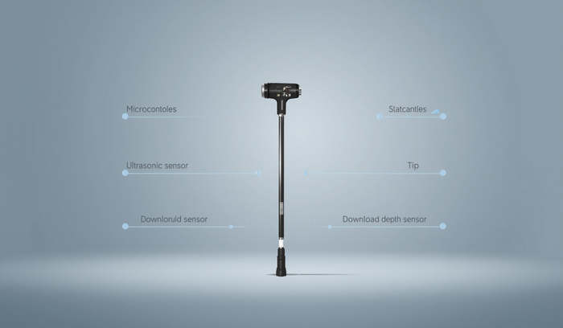
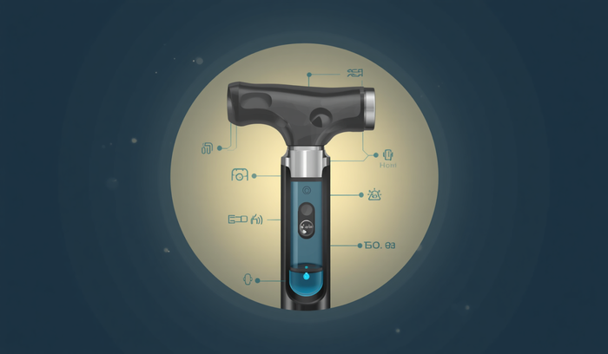
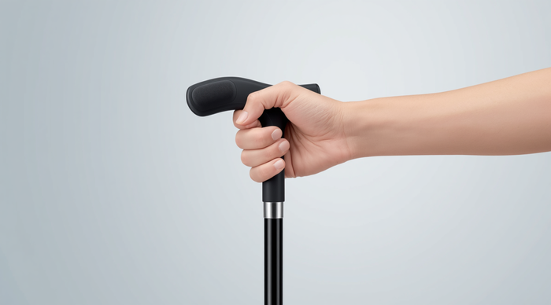

Component Placement on the PathSense Cane
Handle
Grip
Microcontroller and SOS button housed neatly.
Vibration motor for immediate silent feedback.
Sensors
Ultrasonic and depth sensors ensure navigation safety.

Slide 8
Practical Strengths of PathSense
01
Low Cost
Estimated build cost is affordable for users.
02
Proven Components
All core parts are well-documented and accessible.
03
Retrofit Design
Attaches to standard canes, requiring no custom builds.

Slide 9
Next Steps
Sensor Logic
Component Sourcing
Field Testing
Feature Exploration
Finalizing and testing sensor logic in simulation ensures the functionality works as expected before moving to the physical prototype, minimizing potential issues during the build phase.
Sourcing components for the physical prototype will begin once the simulation is validated, allowing us to gather all necessary parts for assembly efficiently and effectively.
Conducting field tests on real pavement conditions will help us refine the sensor thresholds and ensure accurate obstacle detection and responses in varied environments.
Exploring and integration for the SOS feature will enhance user safety, providing reliable emergency communication options directly from the PathSense device during critical situations.

Slide 10

Thank You
PathSense: Confident Navigation for All

